Slide 1
Distributed Tracing
Observability in a microservice world

Slide 2
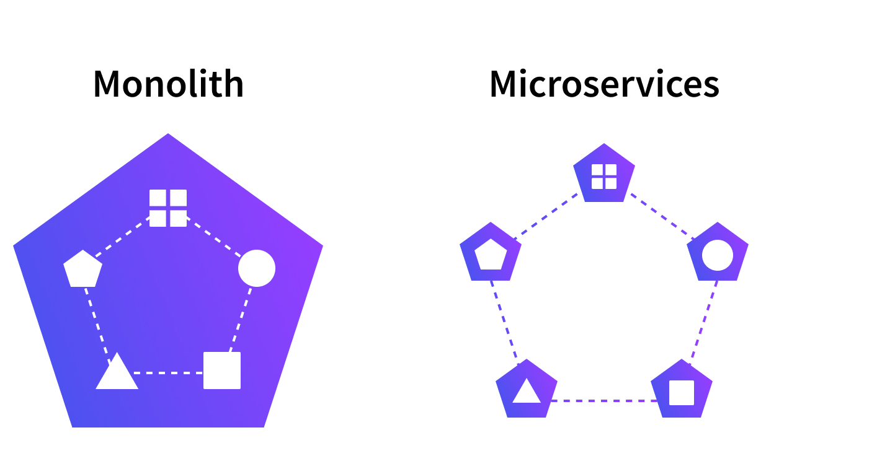
Microservices vs Monoliths
Benefits of microservices:
Scalability
Fault tolerance
Better for managing teams

Slide 3
The Problem
Debugging monoliths can be hard
Debugging microservices is harder
Same problem applies to performance profiling
Notes:
<number>

Slide 4
What is distributed tracing?
Way of observing requests as they propagate through an environment
Each service responsible for generating spans
A span represents a single step along the request path
When combined they form a trace which tells us the entire route of a request
Notes:
<number>

Slide 5
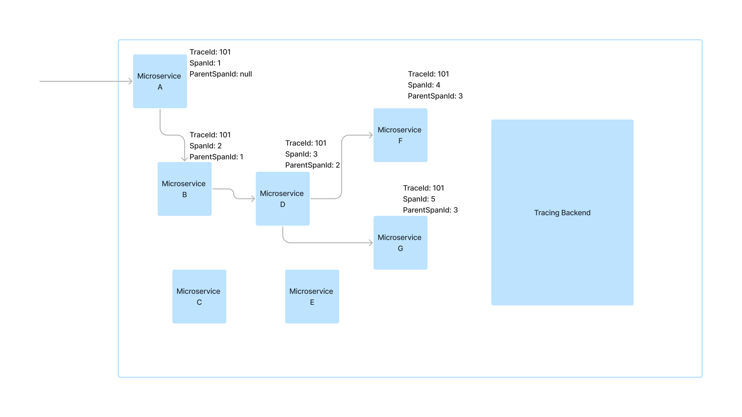

Slide 6
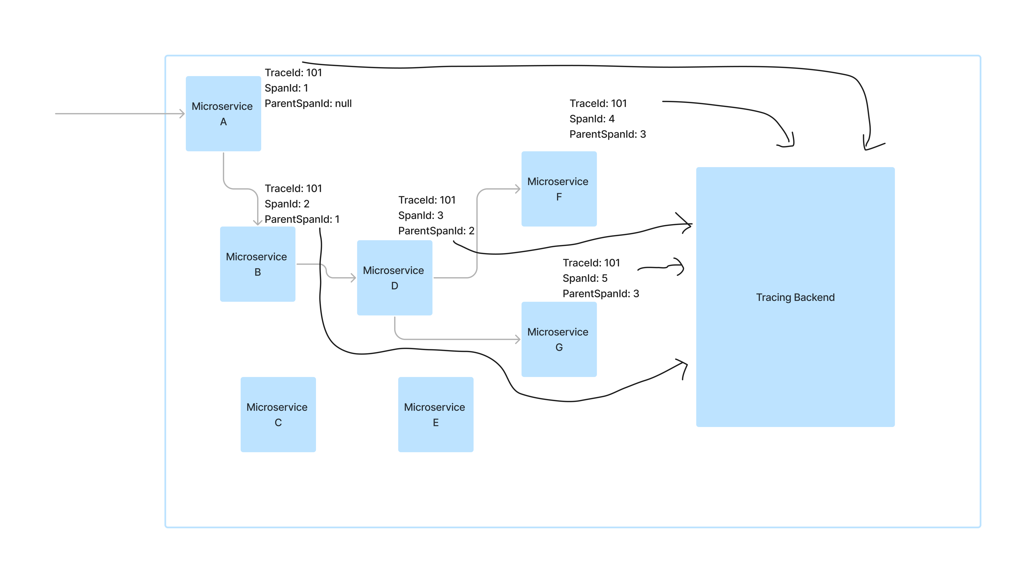
Notes:
<number>

Slide 7
What is a span/trace?
[
{
"traceId": "5982fe77008310cc80f1da5e10147517",
"name": "get",
"id": "bd7a977555f6b982",
"timestamp": 1458702548467000,
"duration": 386000,
"localEndpoint": {
"serviceName": "zipkin-query",
"ipv4": "192.168.1.2",
"port": 9411
},
"annotations": [
{
"timestamp": 1458702548467000,
"value": "sr"
},
{
"timestamp": 1458702548853000,
"value": "ss"
}
]
},
...

Slide 8
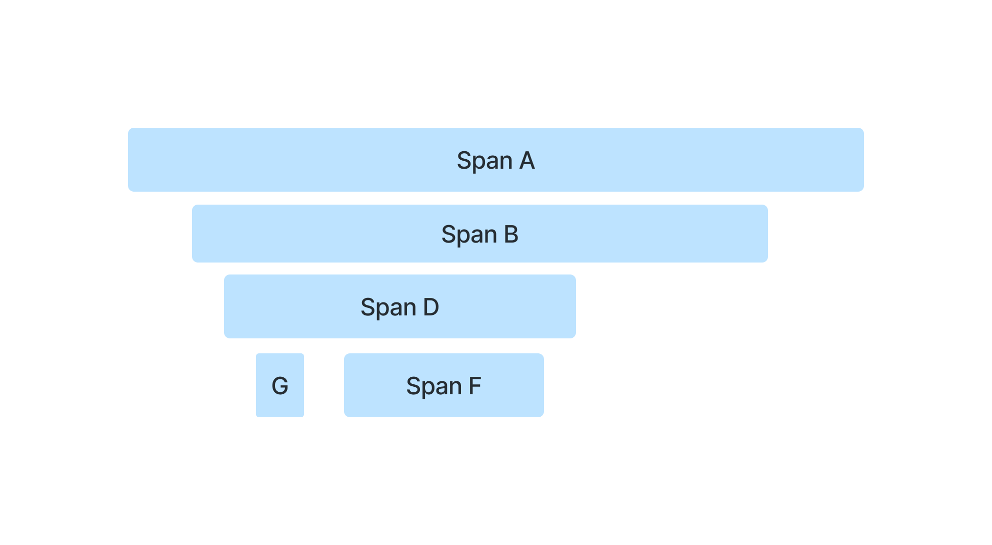
Tracing Backend
Responsible for receiving spans and linking them to form a trace

Slide 9
How does Istio help?
3. Service is responsible for adding trace headers to outgoing requests
(context propagation)*
service
service
1. Incoming http request with no trace headers
4. Http request sent with trace headers
proxy
proxy
2. Proxy generates trace headers before forwarding request to service
5. Proxies send spans to tracing backend asynchronously
Tracing Backend

Slide 10
Context propagation
?

Slide 11
Context propagation
Allows spans to be grouped together to form a trace
Allows spans within a trace to be correlated to show their relationships
Necessary to facilitate tracing with Istio
x-request-id
x-b3-traceid
x-b3-spanid
x-b3-parentspanid
x-b3-sampled
x-b3-flags
b3

Slide 12
Demo
2 services deployed in the service mesh:
Forward
Takes a url
Makes a get request to the url specified its request payload
Returns response from outgoing request
Return
Returns http headers from incoming request in the return body
Source code and instructions at:
https://github.com/lwebbz/TracingDemo

Slide 13
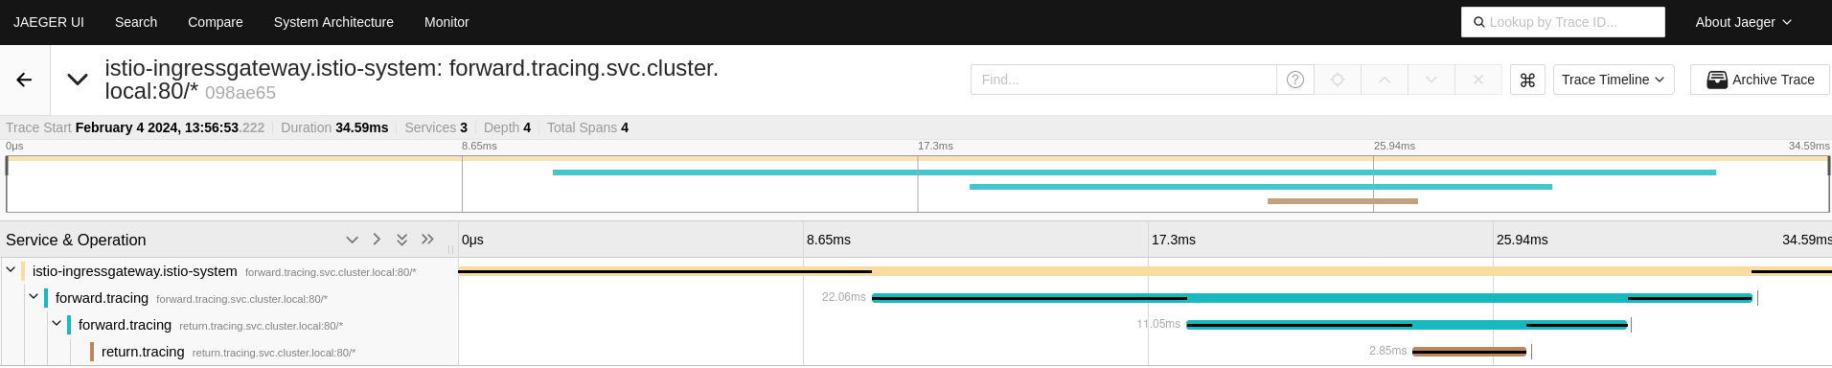

Slide 14
